Slide 1
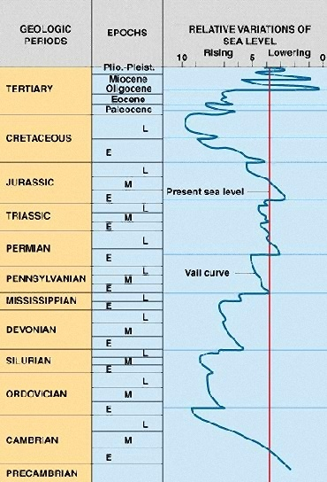
EVENTS
Pangaea
Orogeny
Rapid Sea Floor Spreading
Sediment Transfer into Oceans
Pannotia
Notes:
The first great transgression ends as world wide sea levels fall in response to the first of several collision orogenies that will culminate in the formation of Pangaea. Remember that orogeny decreases continent area and the corresponding increase in ocean area initially lowers sea level.

Slide 2
EVENTS
Pangaea
Sediment Transfer into Oceans
Orogeny
Rapid Sea Floor Spreading
Sediment Transfer into Oceans
Pannotia
Notes:
But as the mountains erode, sea level slowly increases due to sediment transfer into the oceans. Whether or not this transgression deposited any sediment in the Grand Canyon area is unknown, for there is no Ordovician or Silurian strata in the canyon. It may have never deposited, …

Slide 3
EVENTS
Pangaea
Orogeny
Sediment Transfer into Oceans
Orogeny
Rapid Sea Floor Spreading
Sediment Transfer into Oceans
Pannotia
Notes:
… or perhaps it was completely eroded when sea levels plummeted as a second collision orogeny adds another chunk of land to the growing supercontinent of Pangaea.

Slide 4
EVENTS
Pangaea
Orogeny
Slower Sea Floor Spreading
Sediment Transfer into Oceans
Orogeny
Rapid Sea Floor Spreading
Sediment Transfer into Oceans
Pannotia
Notes:
Slower sea floor spreading rates may also have contributed to the low sea levels at the beginning of the Devonian. Importantly, this graph shows only global sea level variations. Local sea level will also be affected by any uplift or subsidence of the land in that area. Thus, if the Grand Canyon area had underwent more uplift during the Ordovician and Silurian than the synchronous global rise in sea level, a regression could have actually occurred in the area. We simply don’t know whether there was a transgression or regression in the Grand Canyon area during the 165 million year interval that spans the Ordovician and Silurian periods.

Slide 5
EVENTS
Pangaea
Sediment Transfer into Oceans
Orogeny
Slower Sea Floor Spreading
Sediment Transfer into Oceans
Orogeny
Rapid Sea Floor Spreading
Sediment Transfer into Oceans
Pannotia
Notes:
We do have a record, albeit spotty, of Devonian transgression in the canyon, which may once again have been the result of sediment transfer into the oceans following orogeny and erosion.

Slide 6
The “Second” Transgression
Notes:
Although this transgression may or may not have been the third in the area, we will nonetheless call it the second, because it is the second time transgression left any sedimentary record in the canyon.

Slide 7
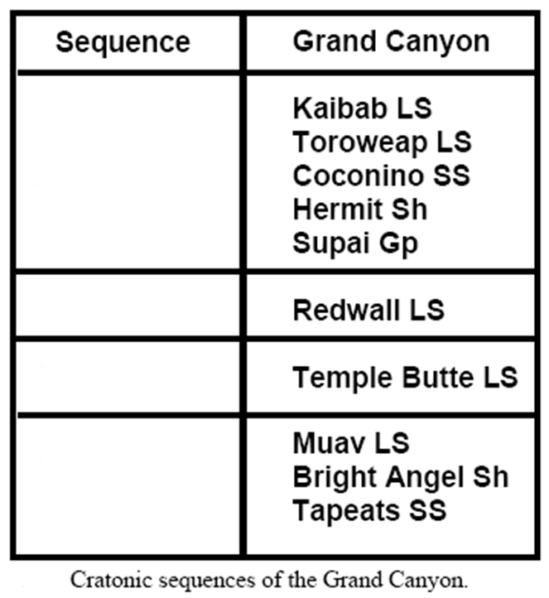
KNOW THE CANYON’S HISTORY
STUDY ROCKS TRULY MADE BY TIME
4th
3rd
2nd
1st
Notes:
The unit deposited during this transgression is the Devonian Temple Butte Limestone and it corresponds to “Truly” in our handy mnemonic.

Slide 8
Eroded Muav Limestone seafloor
Notes:
During the Devonian Period the region was again awash in shallow seas which now covered an eroded Muav Limestone sea floor.

Slide 9
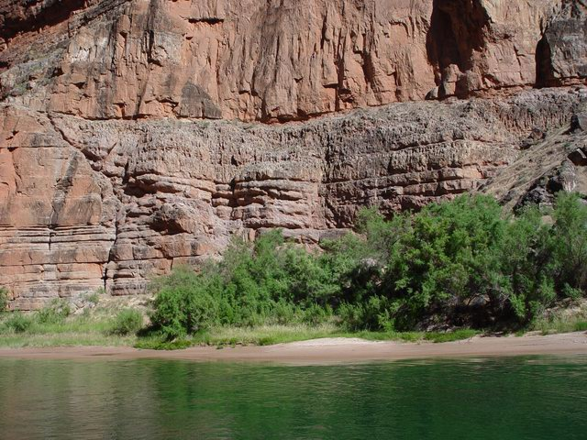
Redwall
Temple Butte
Muav
Notes:
In the eastern part of the canyon the Temple Butte Limestone generally outcrops as thin lenses that terminate against the sides of former stream and tidal channels carved into the Muav Limestone.

Slide 10
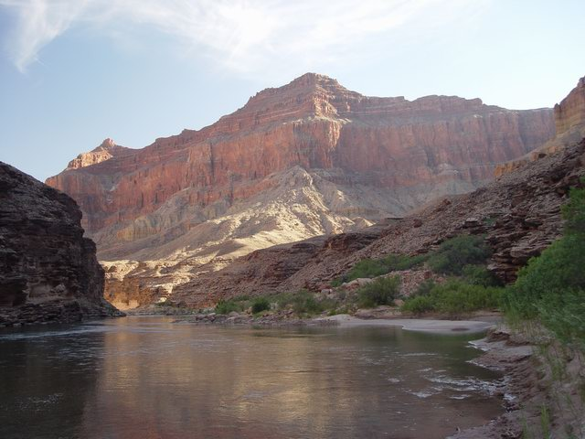
Temple Butte
Notes:
In the western part of the canyon, which was farther offshore during the Devonian, the Temple Butte’s thickness increases markedly. Here we see the “type locality” for the Temple Butte Limestone.

Slide 11
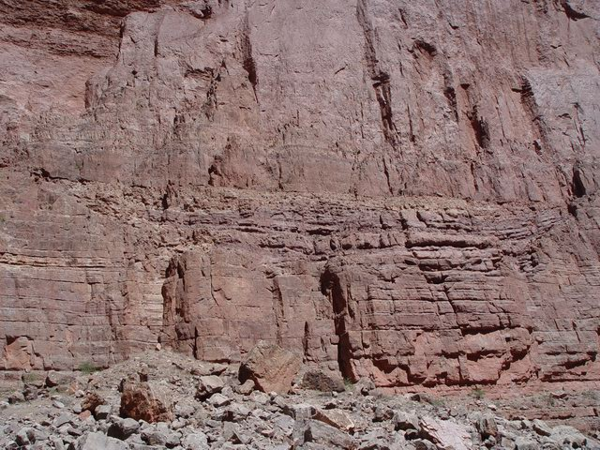
Redwall
Temple Butte
Muav
Why no shale or sandstone?
Notes:
Now back to the eastern section for a moment where we see another lens within the Temple Butte. If the sea transgressed over the Muav Limestone, why don’t we see sandstone and shale deposited before the Temple Butte Limestone? Remember that the Tapeats Sandstone and Bright Angle Shale were deposited before the Muav Limestone. Pause the video and see if you can come up with an explanation. When you think you have one, resume.

Slide 12
Eroded Muav Limestone seafloor
Notes:
Well, unlike the Cambrian transgression which occurred on an eroded Proterozoic basement of largely silicate rocks, the Devonian transgression occurred on soluble carbonates, which largely dissolved upon erosion and therefore produced very little insoluble sand and mud.

Slide 13
The Third Transgression
Notes:
A relatively brief regression followed the deposition of the Temple Butte Limestone, but by the middle of the Mississippian period, a third transgression was in full force.

Slide 14
KNOW THE CANYON’S HISTORY
STUDY ROCKS TRULY MADE BY TIME
4th
3rd
2nd
1st
Notes:
The unit deposited during this transgression is the Mississippian Redwall Limestone and corresponds to the word “Rocks” in our mnemonic.

Slide 15
Notes:
The combination of global sea level rise and subsiding land led to a profound transgression that covered even more of the western states with shallow seas than did the previous transgression. With the shoreline even farther from the Grand Canyon during the deposition of the Redwall than it was during the deposition of either the Temple Butte or Muav Limestones, …

Slide 16
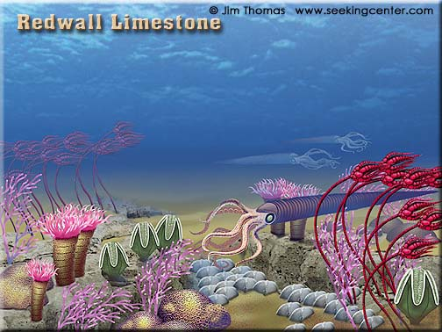
Notes:
… the sea water here was extremely clear and the Redwall Limestone is therefore almost entirely pure calcium carbonate formed from accumulated shell material. Typical fossils include crinoids, bryozoa, brachiopods, coral, and cephalopods.

Slide 17
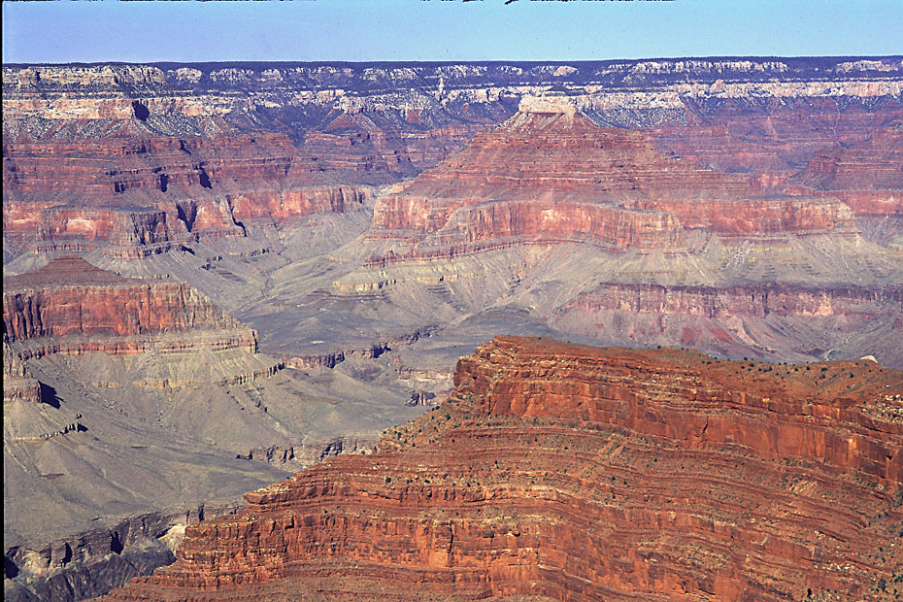
Redwall Limestone
Notes:
As one of the most conspicuous cliff formers in the Grand Canyon and thoroughly red-stained from iron oxidizing in the units above it, the Redwall Limestone is aptly named.

Slide 18
Notes:
Where the river has washed away the iron staining, the true blue-grey color of the Redwall Limestone is visible.

Slide 19
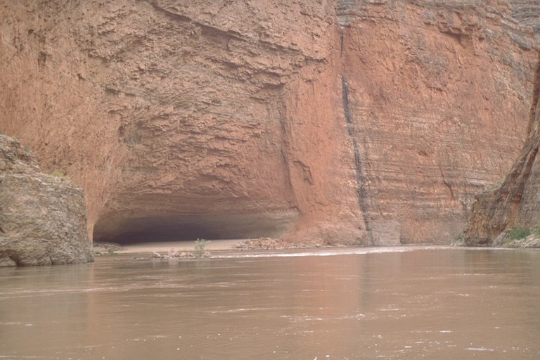
Redwall Cavern
Notes:
At Redwall Cavern, the river has completely dissolved the Redwall Limestone - a dramatic example of its high solubility.

Slide 20
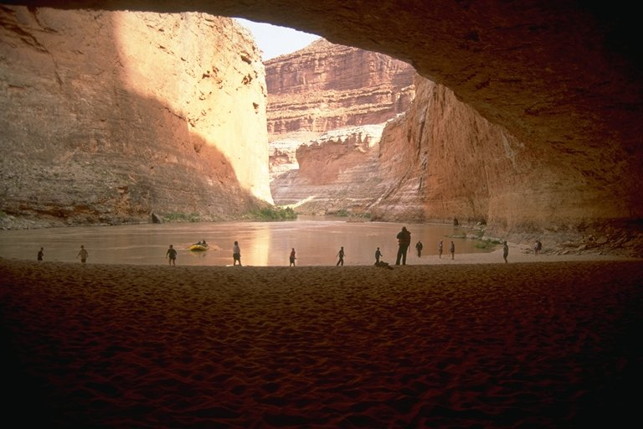
Redwall Cavern
Notes:
The giant cavern is a popular stop with raft trips.

Slide 21
EVENTS
Pangaea
Orogeny
Sediment Transfer into Oceans
Orogeny
Slower Sea Floor Spreading
Sediment Transfer into Oceans
Orogeny
Rapid Sea Floor Spreading
Sediment Transfer into Oceans
Pannotia
Notes:
A rather profound recession followed the deposition of the Redwall Limestone, during which time it was uplifted and eroded.

Slide 22
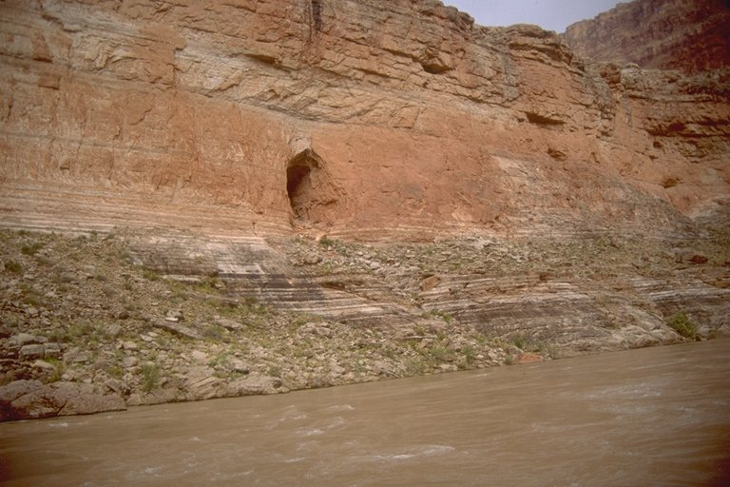
Stanton’s Cave
Notes:
Caverns developed in the soluble Redwall at this time, many of which can be seen along the river.

Slide 23
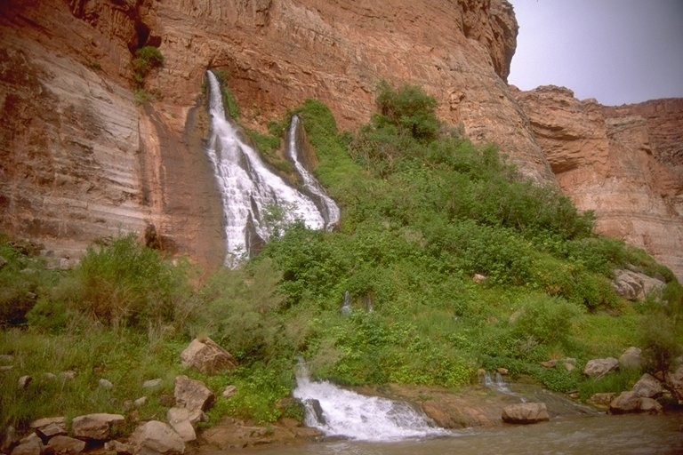
Vasey’s Paradise
Notes:
Some of these provide conduits for modern groundwater flow.

Slide 24
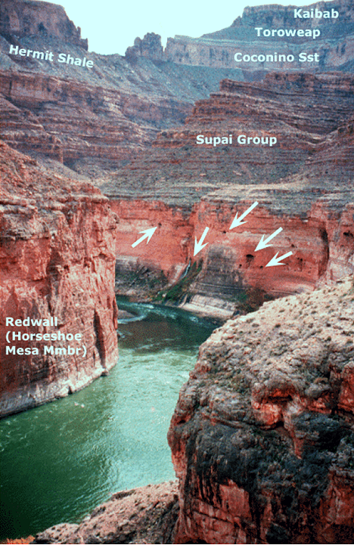
Notes:
The extensive cave system at Vasey’s Paradise with over 2 miles of passageways, indicates that the Mississippian erosional period was quite significant. Of course the Redwall Limestone is exposed to erosion today, so there are modern caves that have developed in the Redwall as well. Some of the modern Redwall caves have speleothems that must form just below the water table and thus indicate that the canyon was at least partly eroded at the time they formed.

Slide 25
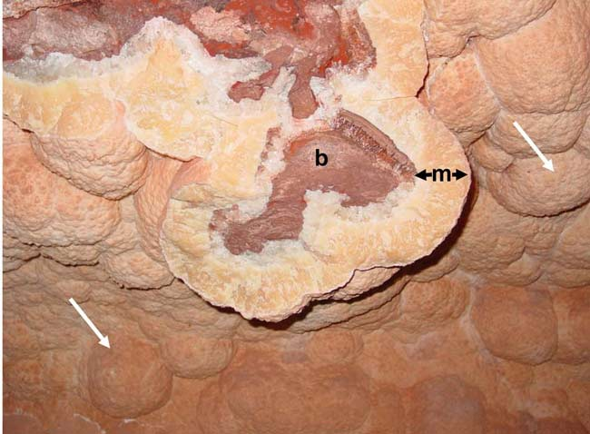
mammillary
mammillary
Notes:
By dating such speleothems, known as cave mammillaries, the age of Grand Canyon formation has been pushed back to 16-17 million years ago. Centered in the photo is a broken-open mammillary exposing the Redwall Limestone beneath the mammillary crust (m).

Slide 26
EVENTS
Pangaea
Orogeny
Sediment Transfer into Oceans
Orogeny
Slower Sea Floor Spreading
Sediment Transfer into Oceans
Orogeny
Rapid Sea Floor Spreading
Sediment Transfer into Oceans
Pannotia
Notes:
That mammillary stuff is cool, I know, but we need to get back to the Mississippian regression, which not only resulted in cave formation, but also, ….

Slide 27
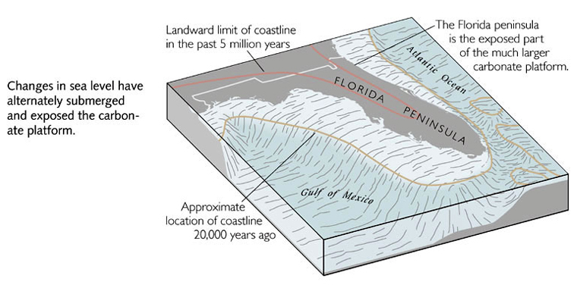
Notes:
… in a similar manner to what happened in Florida during intervals when sea level dropped, …

Slide 28
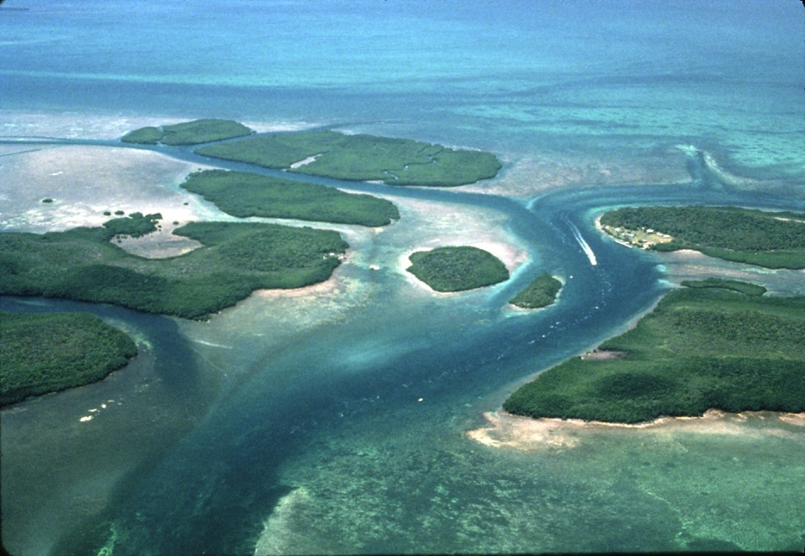
Relict stream channel through keys
bay
ocean
Notes:
… runoff carved stream channels across the carbonate platform.

Slide 29
Notes:
In the Grand Canyon region similar channels later filled with reworked carbonate debris to become …

Slide 30
Notes:
… the Surprise Canyon Formation. This mode of occurrence is similar to the Temple Butte Limestone, but the Surprise Canyon Formation only outcrops in remote areas of the canyon and was not discovered until 1985. Accordingly we will attach little significance to it and move on to …

Slide 31
The Fourth Transgression
Notes:
… the Fourth Transgression.

Slide 32
EVENTS
Pangaea
Sediment Transfer into Oceans
Orogeny
Sediment Transfer into Oceans
Orogeny
Slower Sea Floor Spreading
Sediment Transfer into Oceans
Orogeny
Rapid Sea Floor Spreading
Sediment Transfer into Oceans
Pannotia
Notes:
The final Transgression recorded in the Grand Canyon occurred during the Pennsylvanian and Permian periods. At this time orogeny associated with the final stages in the assemblage of Pangaea will generate a lot of clastic sediment that will greatly diversify the kinds of sediment accumulating in the Grand Canyon area.

Slide 33
KNOW THE CANYON’S HISTORY
STUDY ROCKS TRULY MADE BY TIME
4th
3rd
2nd
1st
Notes:
Accordingly, there are five distinctly different units deposited during this interval – the Kaibab, Toroweap, Coconino, Hermit and Supai, or in our mnemonic: “Know The Canyon’s History Study”!

Slide 34
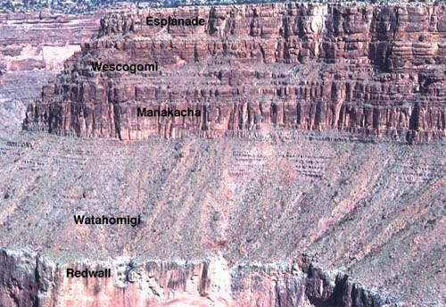
Supai Group
Notes:
Pennsylvanian deposition begins with the Supai Group – a unit so variable that it contains four distinct geologic formations (don’t worry about their names). The various layers represent a variety of changing environments, …

Slide 35
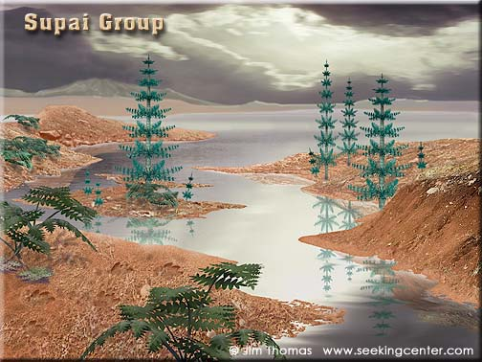
Notes:
… including marginal marine (delta, estuary, lagoon and tidal flat) and shallow marine, similar to the Texas Gulf today. This scene attempts to interpret these marginal marine environments with scant vegetation (ferns and calamities- giant horsetails) and animal tracks of an unknown species. Red colored sediments, or “red beds” as geologists usually call them, almost always indicate that the sediments where exposed above sea level where highly oxygenated rain water could oxidize iron-bearing minerals derived from the erosion of distant mountains.

Slide 36
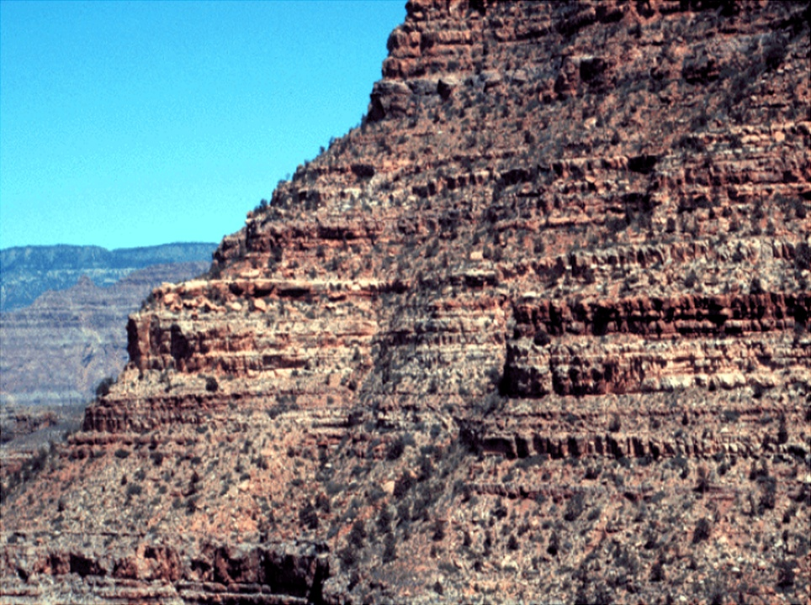
Supai Group
Notes:
It is primarily the Supai Group which provided the iron oxide which colored the Redwall Limestone below.

Slide 37
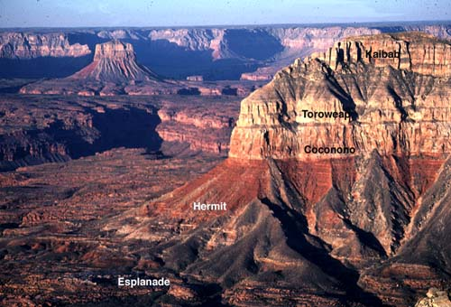
Notes:
Above the variable beds of the Supai Group lay the soft, vivid red slopes of the Hermit shale. The color of these siltstones and mudstones absolutely screams oxygen!

Slide 38
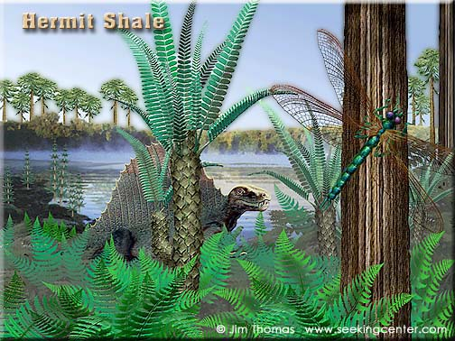
Notes:
It should therefore be of no surprise that the Hermit Shale represents a coastal lowland environment, probably a lagoon on the edge of a tropical sea, where extensive rain thoroughly oxidized the sediments. Some layers are rich with plant fossils (see inset), indicating occasional swampy conditions. The animal in this scene is a Dimetridon and more of a lizard than a dinosaur. True dinosaurs won’t appear until the Triassic period. The trees are conifers similar to the trees responsible for the petrified wood in the Petrified Forest southwest of the Grand Canyon. Giant Horsetails and ferns fill out the scene. The lush world of the Hermit Shale will almost completely dry out as several factors will join forces in towards the middle of the Permian to make much of North America a desert.

Slide 39
EVENTS
Pangaea
Orogeny
Sediment Transfer into Oceans
Orogeny
Sediment Transfer into Oceans
Orogeny
Slower Sea Floor Spreading
Sediment Transfer into Oceans
Orogeny
Rapid Sea Floor Spreading
Sediment Transfer into Oceans
Pannotia
Notes:
First on the drying list is the precipitous fall in sea level that accompanied orogeny associated with the final assemblage of Pangaea. Notice that this is the lowest global sea level of the entire Paleozoic. As sea levels fall, continental area increases and larger continents tend to be more arid.

Slide 40
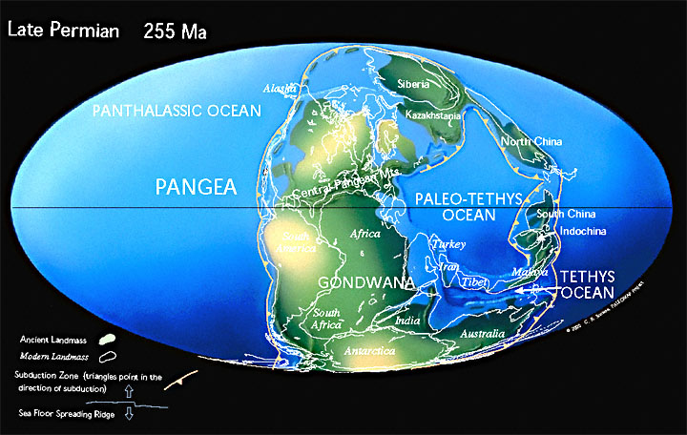
Notes:
The largeness of Pangaea itself also contributed to the aridity as did the location of much of North America which lay in the typically dry sub-tropical latitudes.

Slide 41
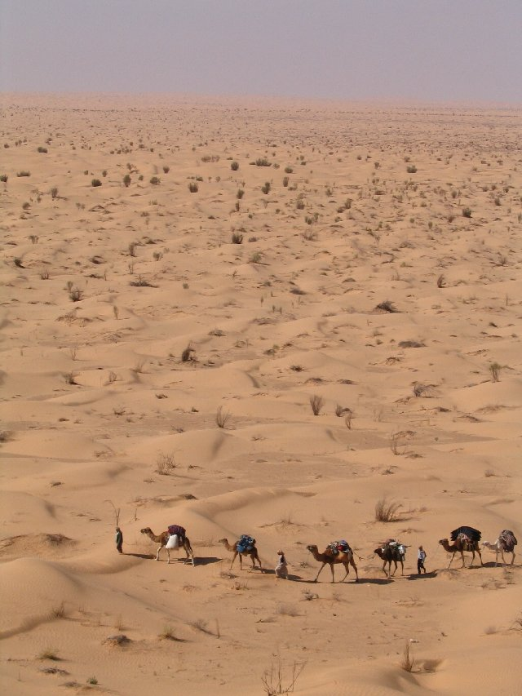
Notes:
Climatic conditions at this time where similar to modern Saharan Africa, and vast dune fields spread across Permian North America.

Slide 42
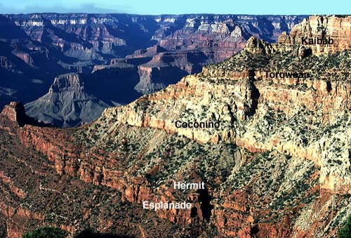
Coconino Sandstone
Notes:
The conspicuous light-colored cliff near the top of the canyon is the Coconino Sandstone and represents this time period.

Slide 43
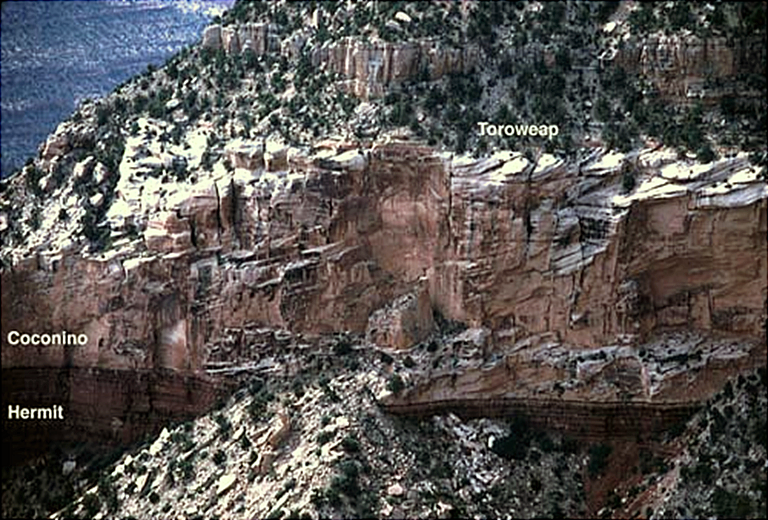
Coconino Cross-beds
Notes:
The high angle cross-beds which are characteristic of this formation are visible from some distance and are indicative of its windblown origin.

Slide 44
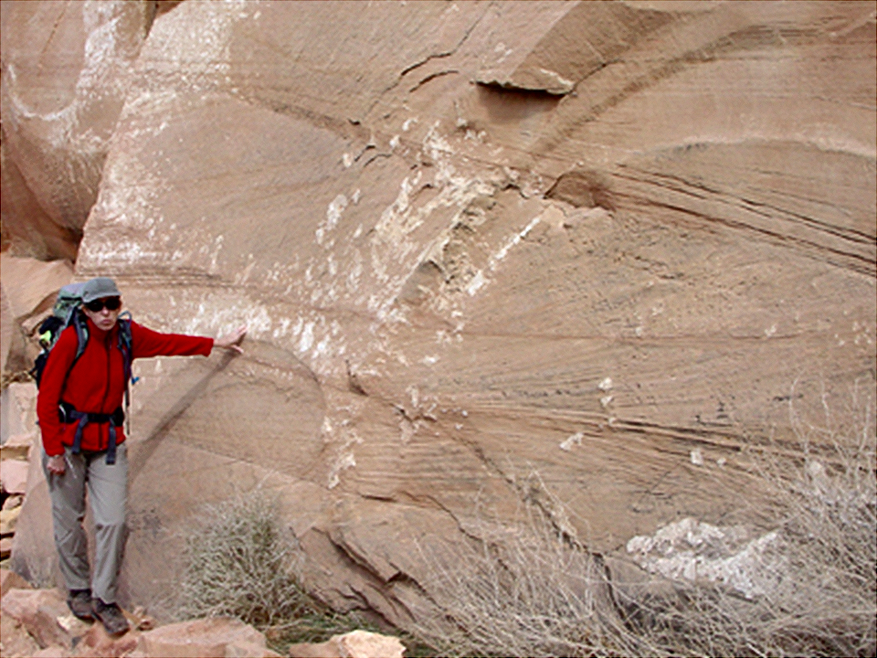
Coconino Cross-beds
Notes:
On closer inspection you can see that the cross-beds slope in different directions because changes in wind direction reshaped the dunes. The light color indicates a very mature sand with few ferromagnesian minerals. Individual sand grains have a “frosted” surface, imparted by countless impacts with other grains.

Slide 45
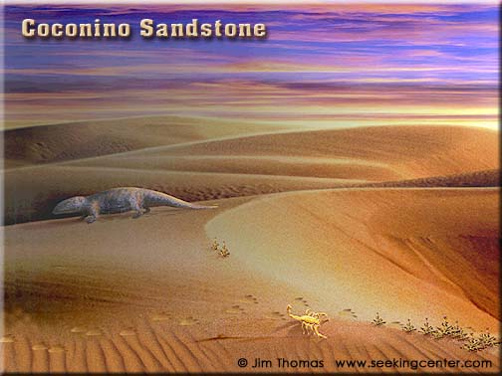
Notes:
Also indicative of the Sahara-like Coconino landscape are the sporadic reptile tracks found throughout the formation (see inset). Vegetation was minimal.

Slide 46
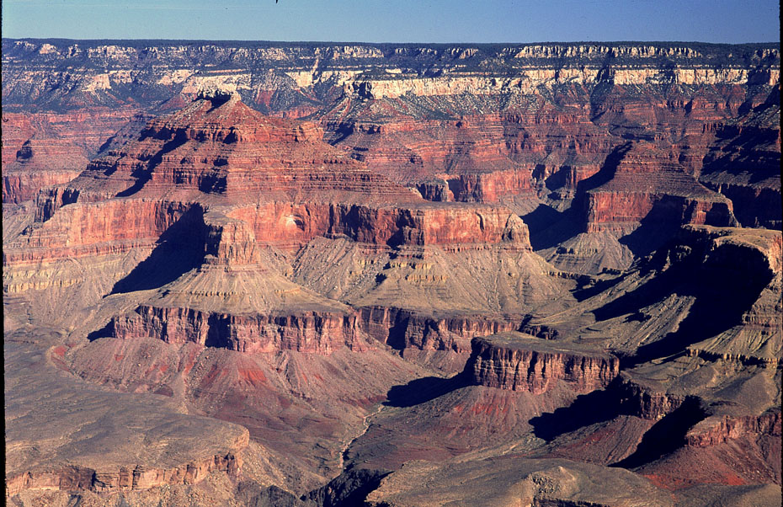
Coconino Sandstone
Notes:
The dune field represented by the Coconino Sandstone covered a vast area …

Slide 47
Dunes
Notes:
… stretching from Mexico to Montana. The mountain ranges built during the formation of Pangaea …

Slide 48
sediment
Notes:
… will eventually erode, add sediment to the ocean and …

Slide 49
EVENTS
Sediment Transfer into Oceans
Pangaea
Orogeny
Sediment Transfer into Oceans
Orogeny
Sediment Transfer into Oceans
Orogeny
Slower Sea Floor Spreading
Sediment Transfer into Oceans
Orogeny
Rapid Sea Floor Spreading
Sediment Transfer into Oceans
Pannotia
Notes:
… once again raise sea level, although just barely above average.

Slide 50
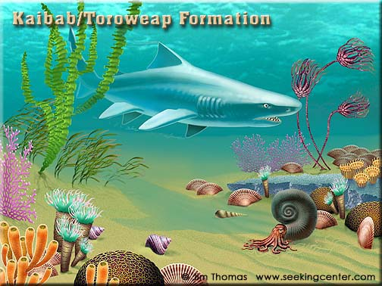
Notes:
Nonetheless the slight rise in sea level was enough to cover the Coconino dune fields with shallow seas because they were only slightly above sea level to begin with. Two units deposited at this time - the Kaibab Limestone and Toroweap Formation. Both deposited in a shallow, warm tropical seas in which marine invertebrates flourished. The scene here includes a shark, sponges, brachiopods, crinoids, bryozoa, rugose corals and a coiled cephalopod. Not surprisingly, these conditions once again led to the deposition of carbonates so both units are mostly limestone.

Slide 51
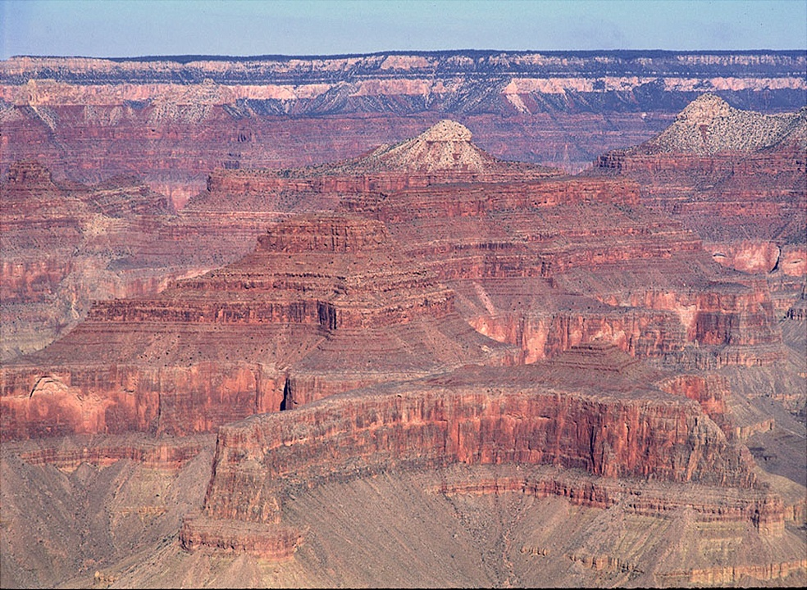
Kaibab Limestone
Toroweap Formation
Notes:
The Kaibab Limestone forms the rim of the Grand Canyon and is easily recognized as the irregular gray cliff which stretches from the rim to the largely tree-covered slope of the Toroweap Formation below. Since the Toroweap Formation deposited on the shifting sands of the Coconino, the limestone is interbedded with sandy layers. There are even a few gypsum layers in the Toroweap indicating local evaporitic conditions. The variability of the Toroweap requires that it be called a “formation”, whereas the regularity of the Kaibab Limestone requires no such designation. There is an unconformity between the two units indicating yet another drop in sea level, …

Slide 52
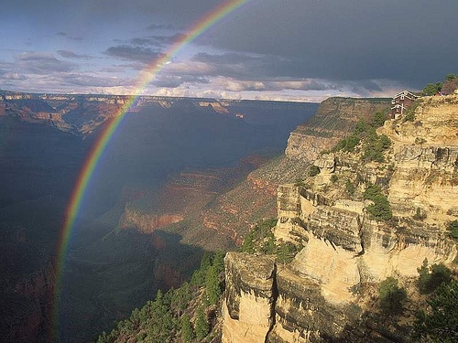
Kaibab Limestone
Notes:
… but when the sea returned to deposit the Kaibab Limestone, the dunes had been sealed and stabilized by Toroweap carbonates, so shorelines were less shifty during Kaibab time. Thus the Kaibab Limestone contains virtually no clastic material and is almost entirely made of skeletal remains.

Slide 53
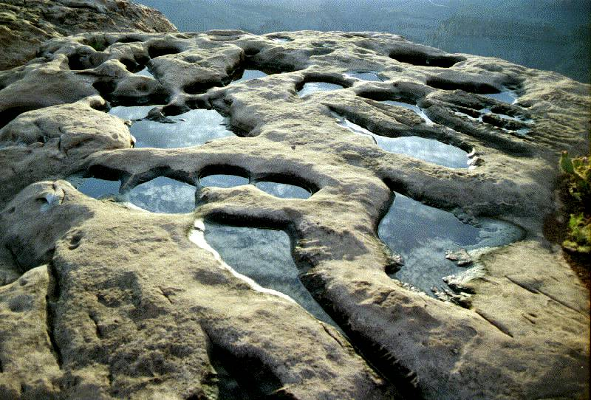
Kaibab Potholes
Notes:
Like most limestones, the Kaibab is susceptible to solution, so potholes and…

Slide 54
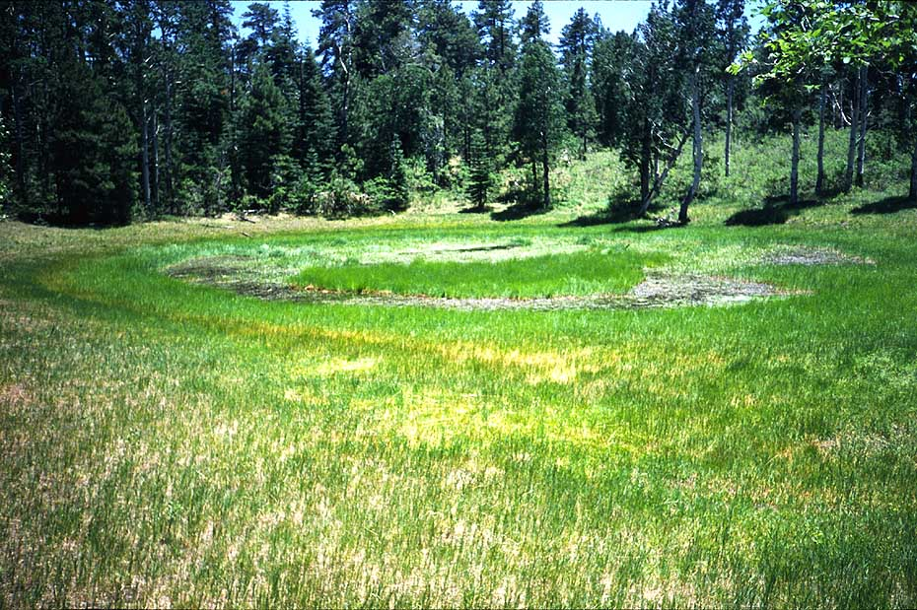
Kaibab Sinkhole
Notes:
… sinkholes are not uncommon. This one has filled with pond sediments. Well we’ve reached the top of the canyon now, but some of the best parts of the story still lie ahead.

